Slide 1
IT8703 Applied Machine Learning - CA 2 Unsupervised & Deep Learning
Lum Kok Keong
NSDAI2 Class 2 (Thursday)

Slide 2
Agenda
Introduction
Part A Unsupervised Learning
Part A Summary
Part B Deep Learning
Part B Summary

Slide 3
Introduction

Slide 4
Introduction (1/2)
Part A Unsupervised Learning :
Given the iris dataset, if we knew that there were k types of iris, but did not have access to a taxonomist to label them: we could try a clustering task: split the observations into well-separated group called clusters.
Dataset : sklearn iris dataset
Part B Deep Learning :
Implement an image classifier using a deep learning network. You may use any of the well-known Deep Learning (DL) network models such as AlexNet, ResNet, etc.
Dataset : MNIST dataset

Slide 5
Introduction (2/2)
References resources used as follow :
https://scikit-learn.org/stable/modules/generated/sklearn.cluster.MeanShift.html
https://blog.cambridgespark.com/how-to-determine-the-optimal-number-of-clusters-for-k-means-clustering-14f27070048f
https://medium.com/coinmonks/understand-alexnet-in-just-3-minutes-with-hands-on-code-using-tensorflow-925d1e2e2f82
http://efavdb.com/mean-shift/
https://towardsdatascience.com/learning-rate-schedules-and-adaptive-learning-rate-methods-for-deep-learning-2c8f433990d1
http://deeplizard.com/learn/video/jWT-AX9677k

Slide 6
I – Unsupervised Learning

Slide 7
Ways of solving the clustering task
Visual Method (K Means Clustering)
Trying different values of K
Calculating Silhouette score
Means Shift Method
Elbow Method

Slide 8
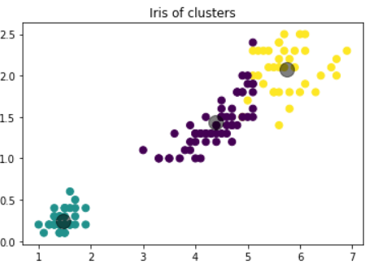
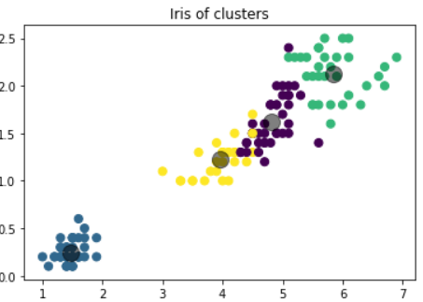
Cluster Number Method (1/6) Using Visual method for guessing Cluster numbers
Cluster of 3
model = KMeans(init='k-means++',n_clusters=3, n_init=10)
Cluster of 4
model = KMeans(init='k-means++',n_clusters=4, n_init=10)

Slide 9
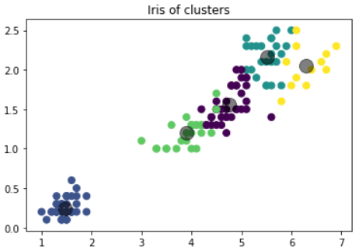
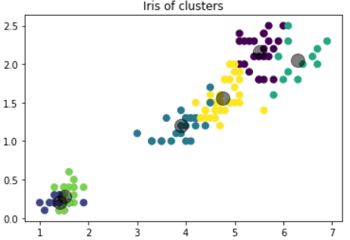
Cluster Number Method (2/6) Using Visual method for guessing Cluster numbers
Cluster of 5
model = KMeans(init='k-means++',n_clusters=5, n_init=10)
Cluster of 6
model = KMeans(init='k-means++',n_clusters=6, n_init=10)
Requires visual to identify the Cluster numbers – May be subjective

Slide 10
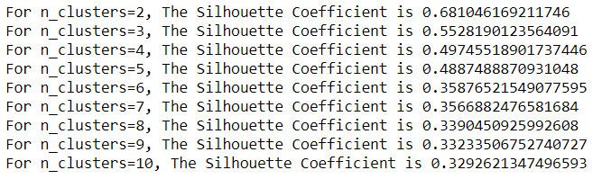
Cluster Number Method (3/6) Using Silhouette for guessing Cluster numbers
A higher Silhouette Coefficient score relates to a model with better-defined clusters.
In this case, n=2 cluster seems to be the best
However, from the visual graph, it seems that the third species is overlapping the other 2 species.
Thus, this does not reflect the optimised Cluster numbers

Slide 11
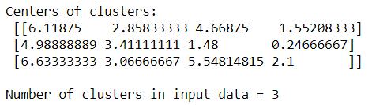
Cluster Number Method (4/6) Using Means Shift for guessing Cluster numbers
bandwidth_X = estimate_bandwidth(X, quantile=0.18, n_samples=len(X))
The number of clusters is dependent upon quantile value chosen.
Hence, it requires educated guess and trial and error method on the quantile number to get the best cluster numbers

Slide 12
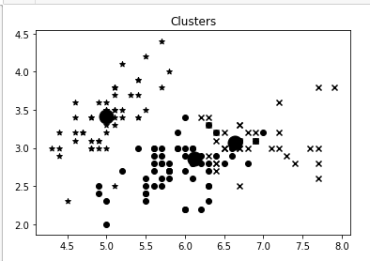
Cluster Number Method (5/6) 2. Using Means Shift for guessing Cluster numbers
Means shift clustering mainly aims to discover blobs
K=3 from the visual graph generated.

Slide 13
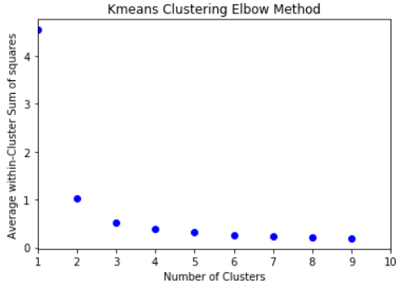
Cluster Number Method (6/6) Using Elbow method for guessing Cluster numbers
The optimal k is the point on the plot which looks like an arm (elbow)
Very clear cut of looking at the optimised cluster numbers
From the plot, k=3 seems to be the optimum.

Slide 14
Summary
Visual method of K means is too subjective and requires human judgment, which might not be accurate
Using silhouette co-efficient might not be accurate as the clusters might overlap
Means shift is able to predict the number of clusters better than the above methods
Elbow method is the easiest method to accurately see the optimal number of clusters based on the graph alone.
The best possible value of k as predicted is k=3

Slide 15
II – Deep Learning

Slide 16
Image Classification using Deep learning(1/4) Using CNN network Model
With the above CNN Basic Model as reference, variants of parameters are tested as stated in the two tables on the right
CNN5 shows the least errors results using the Number of Neurons and layers
Results shows that the increase of layers or neurons may not reduce the error rates
Hence for further improving of the CNN model, these numbers of Neurons and Layers will be used and test others variables as shown in the next Slide
CNN Basic Model

Slide 17
Image Classification using Deep learning(2/4) Using CNN network Model

Slide 18
Image Classification using Deep learning(3/4) Using CNN network Model
CNN11 shows the better errors results with dropout move before flatten
CNN12 & CNN13 tried on dropout rate of 0.1 & 0.3 and shows that 0.2 has the optimum results errors results
CNN14 shows that increase batch size does not improve the error rate and CNN15 proves reducing batch size to 100 is optimised
CNN14 & 15 shows adding batch normalisation & Dropout in each Dense layer improves the error results
By changing the batch size to 100 & Conv2D to 56 together with the batch normalisation & dropout at each layer and reduce epoch to 9, has reduce the error to 0.67%
Changing the learning rate to 0.005 can further reduce the error rate
In CNN19, using step decay learning rate, we discovered that 0.000000005 step learning rate with epoch 80 gives the best error rate to 0.42%

Slide 19
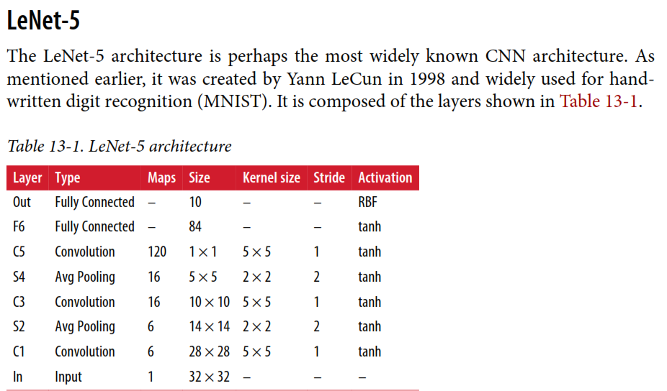
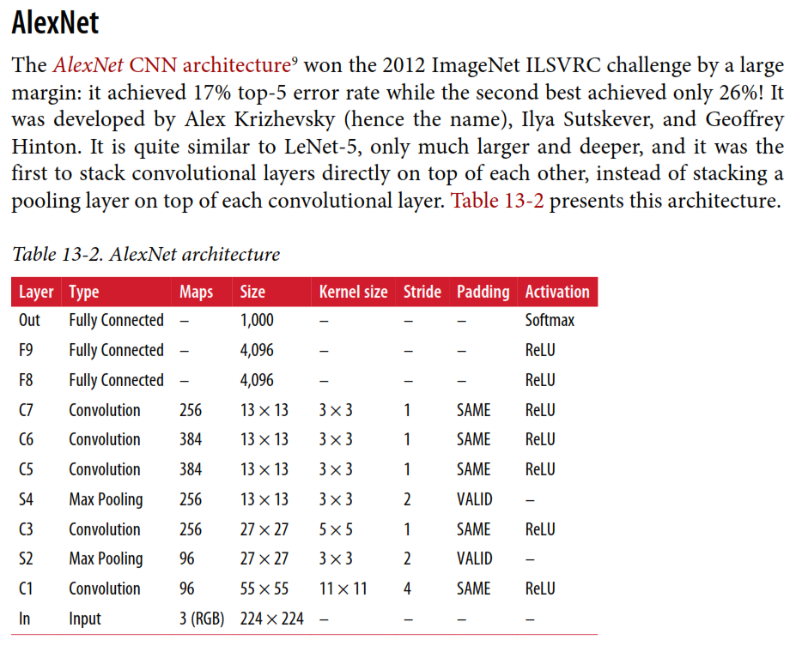
Image Classification using Deep learning(4/4) Using LeNet-5 & AlexNet network Model
LeNet-5 shows better results than AlexNet but cannot beat to CNN which held best at 0.42% error rate shows the least errors results
Results shows that the increase of layers or neurons may not reduce the error rates for 28x28x1 image

Slide 20
Summary (1/2)
Results shows that the increase of layers or neurons may not reduce the error rates using the CNN, LeNet-5 and AlexNet
Increasing the number of layers or Neurons which increase exponential computing power but does not guarantee better results with lesser error.
However it is important know how to reduce the error rate by using the optimum hyper parameters as follow:
filter matrix to able have a better information quality
Dropout rate (to combat the problem of overfitting to the training data)
Batch size (Get optimum size for good quality)
Learning Rate (To get the min loss rate)
Batch Normalisation (transforming the data to put all the data points on the same scale)
Epoch

Slide 21
Summary (2/2)
AleNet is good in Large-Scale higher resolution images but for low resolution image may not be able to perform better than less complex layers of neurons.
Due to time limit, the following are not tried and tested but a good recommendation to be used for further improvement if time and computation power are available :
To improve further, Image Augmentation API provide by Keras (consisted of image translations, horizontal reflections, patch extractions, brightness, contrast, sharpness, blurriness , zoom-in/out etc) can be used to augment data with random rotations, shifts and flips.
Other Model like GoogleLeNet, VGGNet & ResNet

Slide 22
Thank You

